Slide 1
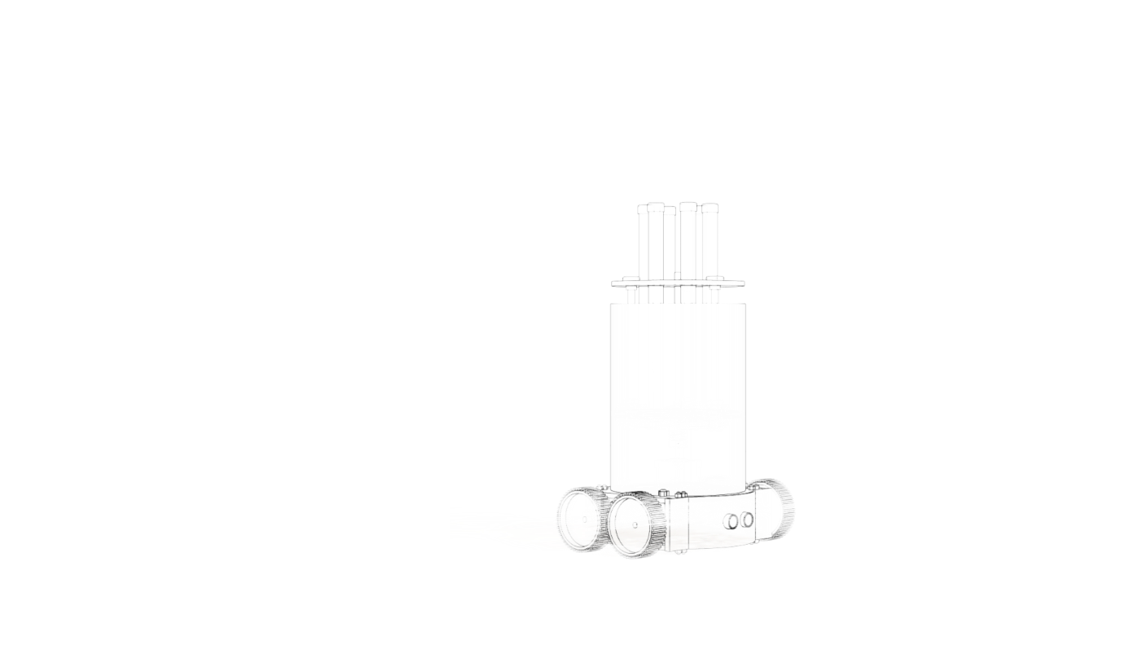

Team ID : T053
Problem ID: COVID 08
Design and Development of Robot to sanitize rooms using Ultra-Violet Rays
PITCH DECK
A simple automatic Home UV Sanitization solution
JEMMA

Slide 2

Problem
KNOWLEDGE of proper procedure to sanitize your environment is an important requirement to stay safe.
AVAILIBILITY of proper cleaning equipment is essential for an effective clean.
TIME is essential for a proper cleaning in house.

Slide 3

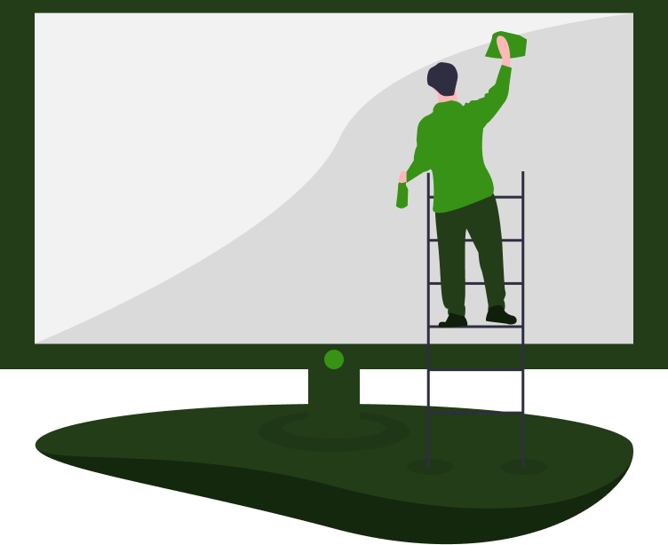

Solution
An automated robotic system for customer to
ENSURE EFFICIENT
cleaning of the environment
ENSURE SAFETY
of human being and surrounding
PROPER UTILIZATION
of the time

Slide 4
Market Validation
google.com
rti.org
5,29,000
93%
Confirmed cases in India as of 28th June,2020
Kill rate of UC-C Germicidal Lamp
3,10,000
Recovered cases in India as of 28th June,2020
ncbi.nlm.nih.gov
95%
16,095
Chances of Asthma to people in contact with liquid disinfectants
Deaths in India as of 28th June,2020

Slide 5
Market Size
840,130
46,209
267
Total Market in India
Total number of doctors in India*
Eligible Market
Doctors who own hospitals in India**
Addressable Market
No. of doctors reachable#
100%
5.5%
0.0317%
* Source: www.ncbi.nlm.nih.gov
** Source: shodhganga.inflibnet.ac.in (Total Clinics : 15,403, assuming each hospital is owned by a trio)
# With initial produce of 30 units per months and 20% growth rate per month

Slide 6
Product

Slide 7
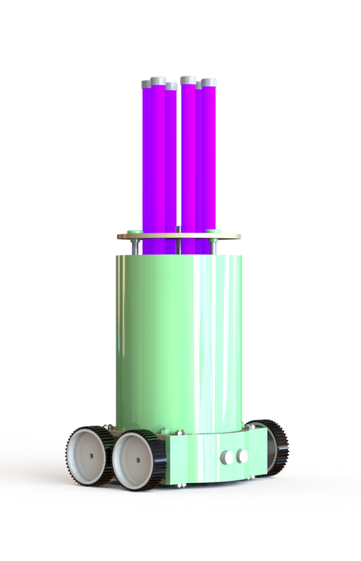
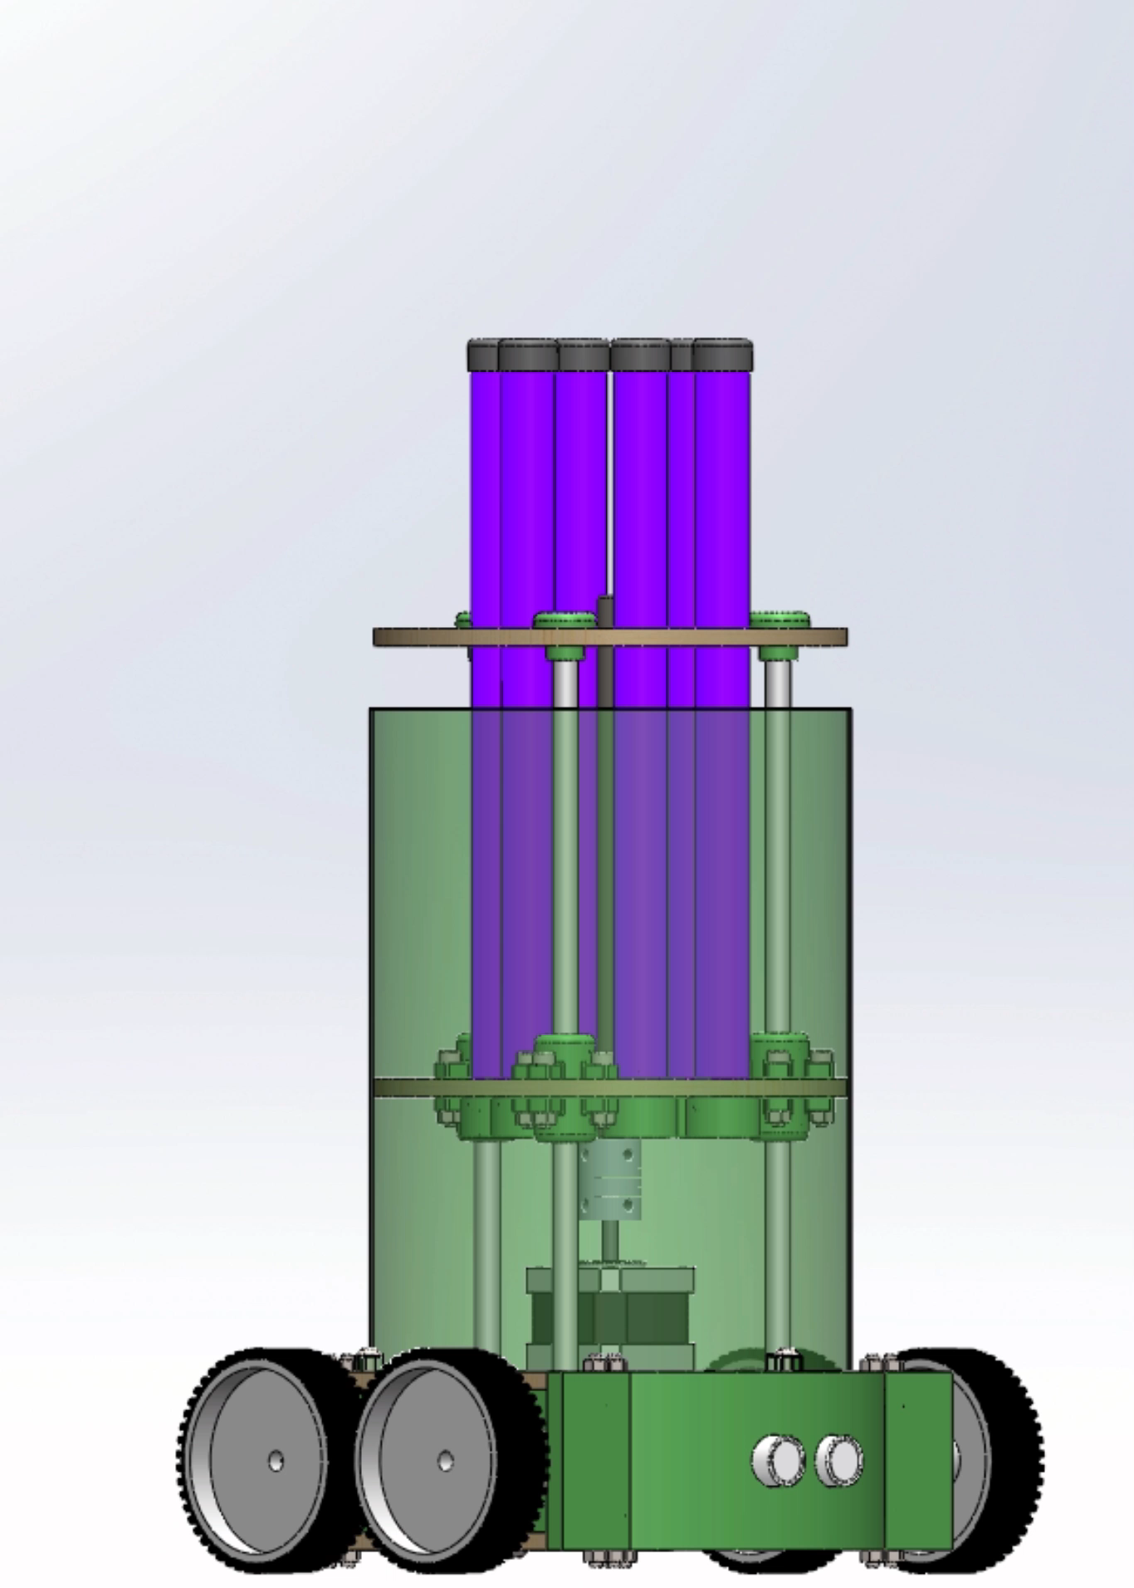

Slide 8
Business Model
We take 33% profit on each unit sold
₹ 2.67 M
₹ 30 K
₹ 8.01 M
PROFITS
UNIT PRICE
ANNUAL TURNOVER
Profit from Products sold
0.0317% of Market Share
33% profit per unit
After calculating postage, taxes and inflation
Annual Revenue
After one year#
* All the data talked about here targets only India
# With initial produce of 30 units per months and 20% growth rate per month

Slide 9



Market Adoption
SOCIAL INFLUENCERS
Are one of the best media advertisements available
PARTNERSHIP
Government of India
Hospitals
Medical stores
LICENSING
Charging royalty from companies to use the Open-Source Designs

Slide 10
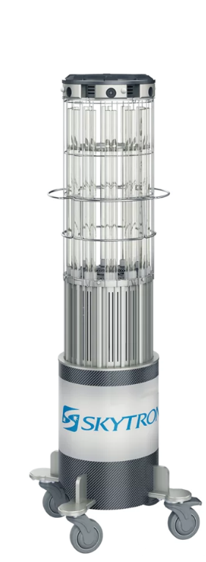
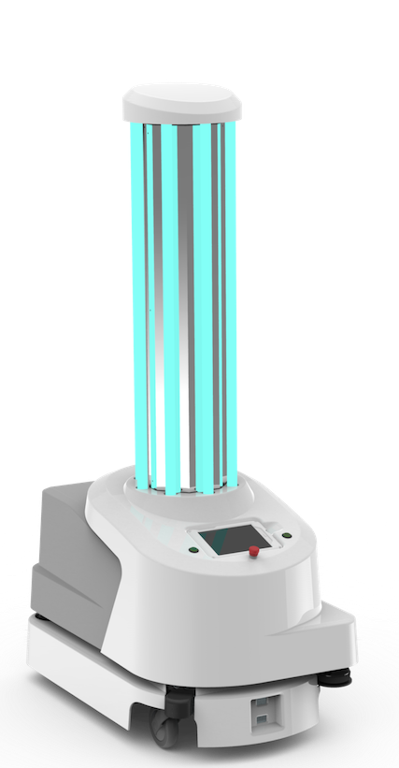
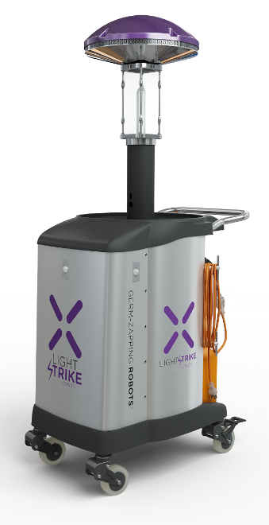
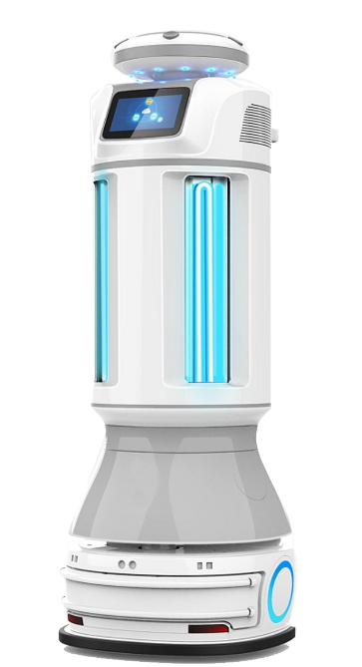
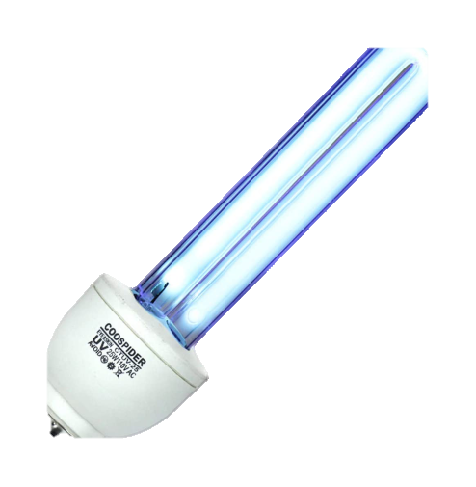
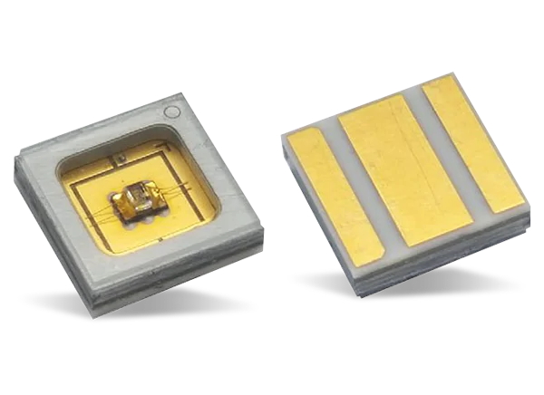
Competition
Lightstrike
XENEX DISINFECTION SERVICES
Connor
ROBOTLAB
1140 Sentry
SKYTRON
UVD Robot
UVD ROBOTS
UV-C Lamp
PUBLIC DESIGN
UV-C LED
PUBLIC DESIGN

Slide 11
Competitive Advantage
UVD ROBOT
1140 SENTRY
US ₹ 30,000
CONNER
SKILL NEEDED
SCALABILITY
₹ 8.75 LAKHS
SAFETY
SKYTRON
Products on right are easy to use but lie in range of 5-9 lakhs.
Products on left of ours are much cheaper but pose of risk of skin damage if knowledge of usage doesn’t exist. Also, they take a lot of time to sanitize
We are currently the only design in market which can be available commercially which targets homes for sanitization using UVGI Lamps.
₹ 350-500
UV-C LAMP/LED
PRICE

Slide 12

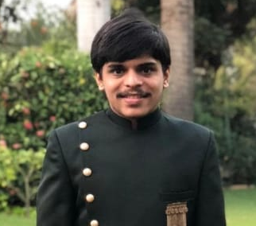
Team
Parth Patel
Electronics Designer
3D Designer, Circuit Design and Programmer
PARIN PATEL
Mechanical Designer
3D Designer

Slide 13
Financial
We are looking for 12 Months financing to reach the sales of 267 Units
₹ 5.3 M
267
₹ 8.01 M
Incubation Funding
Units at ₹ 30K
Revenue
Initial Investment
Avg profit ₹ 10K per unit
After 12 Months

Slide 14
Value to society
This is a time to be safe ourselves and help the community be safe. Humanity first, Business second
Our first motto of this design is to save the humanity and then grow in business. Thus, we have already taken the following steps for the product to be beneficial to society:
The complete design is open-source licensed under CC BY-NC-SA (Attribution-Non Commercial-Share Alike) so the already skilled makers throughout the globe can design it themselves for personal use.
Keeping an easy design in mind, the maximum assembly time is less than 1 hour due to the fact that no post processing is necessary for the parts due to the brilliant design.
Also, the with the low BOM, and identical electrical design and complete SMT design, the complete PCB is PCBA eligible.
Since shipment of the machine overseas can be costly and due to low manufacturing cost, if the product can flourish properly if sold, a licensing fee can be charged to the vendor who wants to self manufacture the parts to sell.

Slide 15
Thank You
We are pleased to help you with your queries regarding the project
QnA

Slide 16
Cost Breakdown
Per unit breakdown of each component of the product is as follows:
Item | Price in ₹
Electronics | 8446
UV Lamps | 1800
Rods + Lead Screw + Nut & Bolts | 800
Wood | 70
Laser Cutting + 3D Printing | 868
Shipping | 2000
Total | 13,984
GST (18%) | 16,501
Post Crisis Inflation (20%) | 19,801
Round off | 20,000

Slide 17
Mechanical Construction
To focus on easy manufacturability and scalability we have chosen the materials wisely
Important points what we kept in mind while design:
Key point of focus was the easy manufacturability of the machine at the time of design due to which each component of the design has more than one feature due to which no. of unique parts in design decrease.
Keeping in Mind the manufacturing process mainly being FDM Manufacturing and Laser cutting, each 3D printed part is designed so it can print without any support or overhang. Also, laser cut parts were kept in mind to be of continuous contour so as to optimize cutting time.
In case of mass production, each 3D printable part is designed to be easily injection moldable without much extra hassle.
Due to symmetric design, the COM lies inside the robot body for a stable operation and COG lies at bottom to avoid topple condition

Slide 18
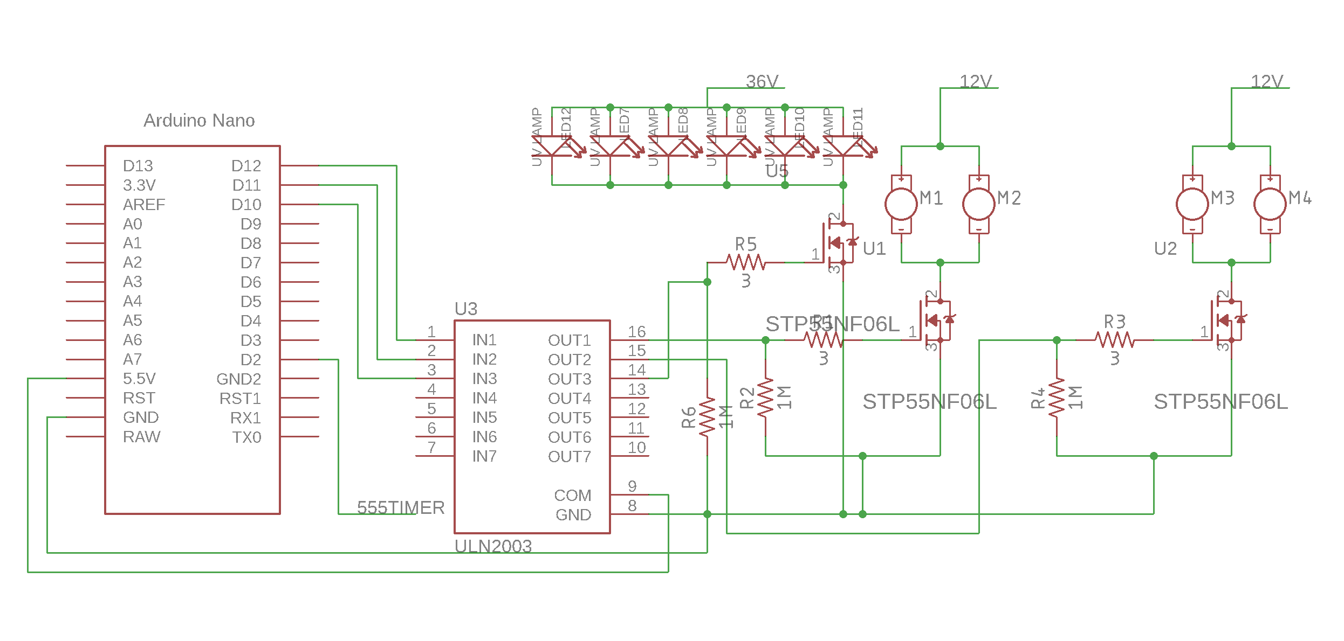
Electronic Construction
To focus on future upgrades and easy repairs following design was made
Important points what we kept in mind while design:
Easy upgrades in future by choosing an independent master slave electronics setup where the function of microcontroller focuses only on motion of robot and all other functions are slave driven.
Presence of indicator LED against each fuse so as to easily detect and correct the fault.
Presence of multiple low capacitance and inductive fuses to detect a parasitic free fault.
Use of higher ratings parts with a minimum safety factor of 2 so as for easy electronics upgrades in near future.

